Slide 1


DEBUGMODE_
http://debugmode.net
SQL Azure to .NET Developers
Dhananjay Kumar

Slide 2

Demos
A First Look on new SQL Azure Portal
Connecting SQL Azure from SQL Server Management studio
Migrating in premise Data Base to SQL Azure
A Look of SQL Azure API
Exposing Database in SQL Azure as OData and LINQ
Using Data from SQL Azure in client Application
Creating a app hosted completely in Azure

Slide 3
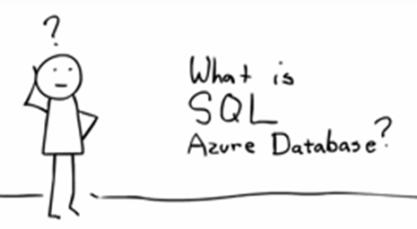
SQL Azure

Slide 4
SQL Azure
SQL Server in Microsoft Data Center
Allows us to create Relational database in cloud
It provides automated management , quick development and elastic scale
SQL Azure features querying data, search, data analysis and data synchronization
Microsoft cloud based Relational Database service

Slide 5
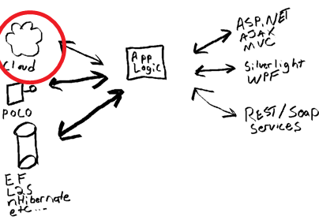
SQL Azure
SQL Azure

Slide 6
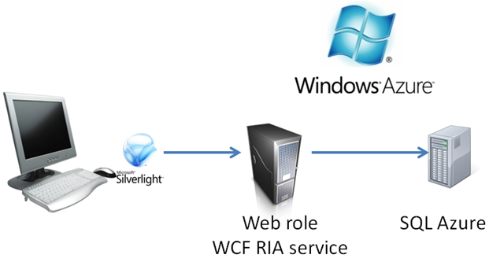
SQL Azure

Slide 7
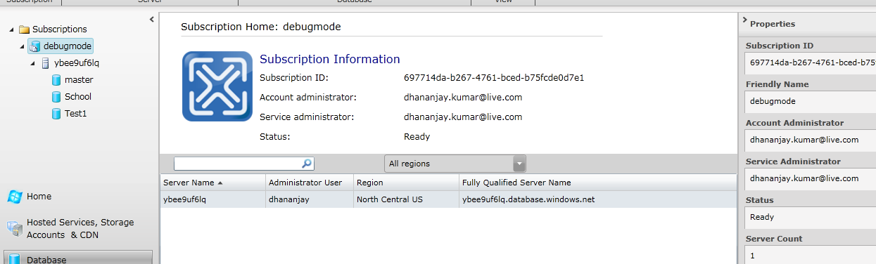
SQL Azure
New SQL Azure Portal

Slide 8
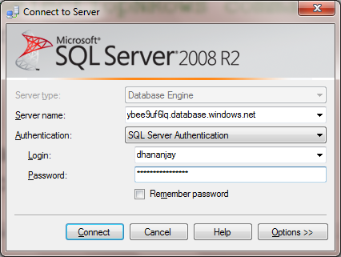
SQL Azure
Connecting Through SSMS

Slide 9
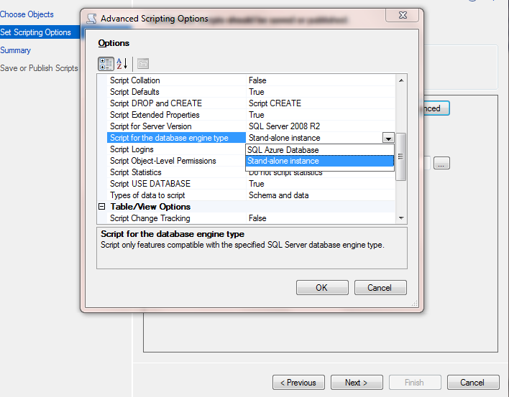
SQL Azure
Migrating LOCAL DB to SQL Azure

Slide 10


SQL Azure
SQL AZURE API
To set the Firewall rule
To delete the Firewall rule

Slide 11
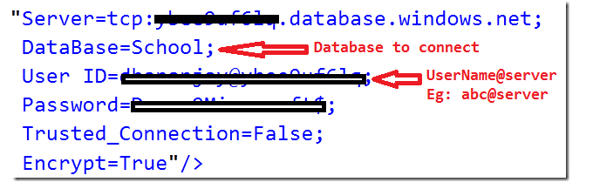
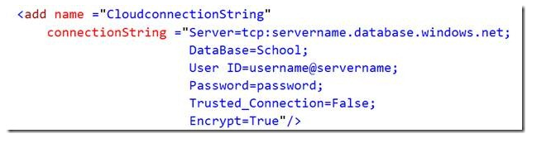
SQL Azure
SQL Azure and ADO.Net

Slide 12
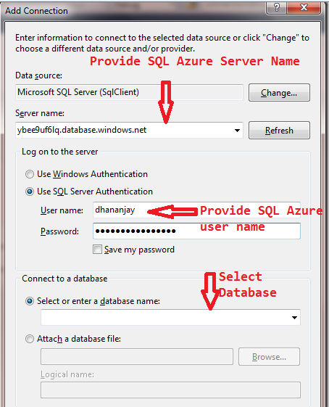
SQL Azure
SQL Azure and LINQ

Slide 13
SQL Azure
SQL Azure and Silverlight client
Expose CRUD operation as WCF Service
Host WCF Service and solve cross domain problem
Consume in Silverlight client
Connect with SQL Azure using either ADO.net , LINQ , OData etc

Slide 14
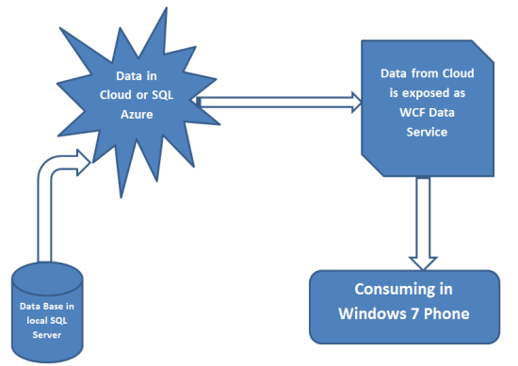
SQL Azure
SQL Azure and Windows 7 Phone

Slide 15
DEBUGMODE_
http://debugmode.net
Suit feedback to,
Dhananjay.25july@gmail.com
Dhananjay Kumar

