Slide 1


DEBUGMODE_
http://dhananjaykumar.net
Introducing WCF
DATA SERVICE
Dhananjay Kumar

Slide 2

Agenda
Quick Demo and introduction of WCF REST service
Introduction to WCF Data Service
Demo Creating your first WCF Data Service
URI Options and Server side paging
Demo performing CRUD from Managed Application
Demo on consuming from WPF client
Demo on consuming from Windows 7 Phone
Q/A

Slide 3
What is REST ?
REST == Representational State Transfer
REST is a architecture style not standard to design and create Service
REST is the Service on the Web
It uses HTTP protocol
It uses URI for resource identification (REST)

Slide 4
WCF Data Service
WCF Data Service
ODATA
Project Astoria
ADO.Net Data Service

Slide 5

WCF Data Service
WCF Data Service
ODATA
Project Astoria
ADO.Net Data Service

Slide 6
ODATA
It is a web Protocol
It is used for updating and querying data
It uses HTTP protocol
It uses ATOM and JSON web message formats
It uses URI for resource identification (REST)
OData is released under the Open Specification Promise to allow anyone to freely interoperate with OData implementations.

Slide 7
ODATA Consumer and Producer
Application :SharePoint 2010, IBM Web Sphere , SSRS, SQL Azure , Azure table
Live Services : facebook ,Pluralsight , vanGuide , TechEd2010, NerdDinner
Browsers , ODATA Explorer , Excel 2010 , LINQPAD, SesName Odata Browser
Client Librarries : W7Phone , Javascript , .Net , PHP
PRODUCER
CONSUMER

Slide 8
WCF Data Service
WCF Data Services Framework Consists of a combination of patterns and libraries that enable the creation and consumption of data services for the web.
The goal of WCF DATA Service is to facilitate the creation of Flexible data Services that are naturally integrated with the web
WCF Data Service exposes CRUD operation as REST service using ODATA protocol

Slide 9
HTTP Verbs
HTTP POST
HTTP GET
HTTP PUT
CREATE Data in Table
RETERIVE Data from table
HTTP DELETE
UPDATE Data in table
DELETE Data in table

Slide 10
Message format
Message Format
ATOM
JSON
JSON for AJAX clients
ATOM for any type of clients

Slide 11
Data Model
Custom Data Model
LINQ to SQL Class
ADO.Net Entity Model

Slide 12
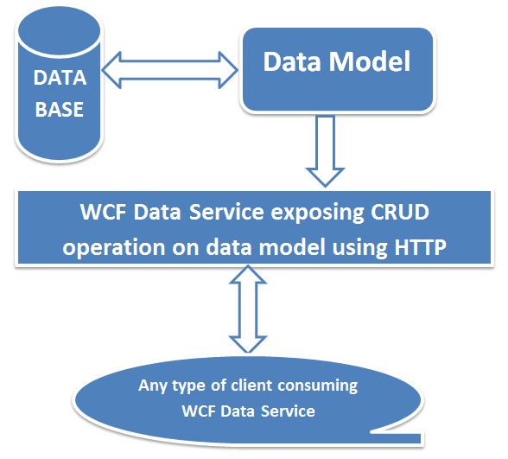
Flow diagram

Slide 13
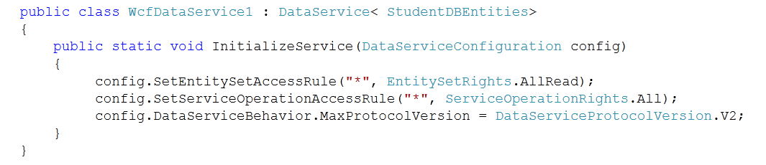
DEMO

Slide 14
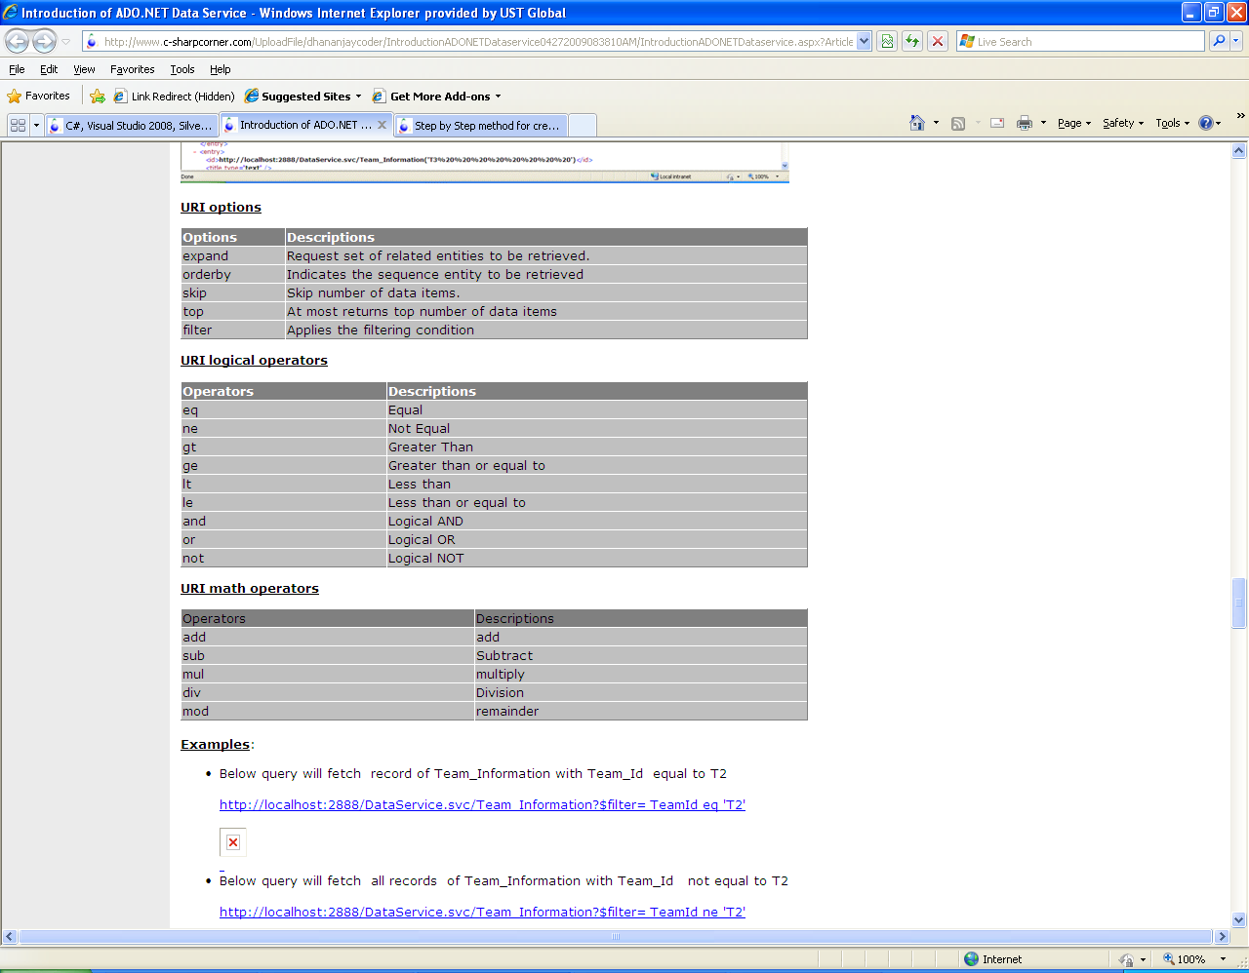
URI options

Slide 15
Create Record
DataServiceContext context = new DataServiceContext(new Uri("http://localhost:7003/WcfDataService1.svc/"));
Blogger blog = new Blogger
{
SpeakerId = 99,
SpeakerBlog = "null",
SpeakerName = "Mr Bill ",
SpeakerTechnology = "Microsoft"
};
context.AddObject("Bloggers", blog);
context.SaveChanges();

Slide 16
Retrieve Record
DataServiceContext context = new DataServiceContext(new Uri("http://localhost:7003/WcfDataService1.svc/"));
SpeakersEntities entities = new SpeakersEntities(new Uri("http://localhost:7003/WcfDataService1.svc/"));
var result = from r in entities.Bloggers select r;
foreach (var r in result)
{
Console.WriteLine(r.SpeakerName + r.SpeakerTechnology);
}

Slide 17
Update Record
DataServiceContext context = new DataServiceContext(new Uri("http://localhost:7003/WcfDataService1.svc/"));
SpeakersEntities entities = new SpeakersEntities(new Uri("http://localhost:7003/WcfDataService1.svc/"));
Blogger blogtoUpdate = (from r in entities.Bloggers where r.SpeakerId == 9 select r).FirstOrDefault();
blogtoUpdate.SpeakerTechnology = "C Sharp ";
context.AttachTo("Bloggers", blogtoUpdate);
context.UpdateObject(blogtoUpdate);
context.SaveChanges();

Slide 18
Delete Record
DataServiceContext context = new DataServiceContext(new Uri("http://localhost:7003/WcfDataService1.svc/"));
SpeakersEntities entities = new SpeakersEntities(new Uri("http://localhost:7003/WcfDataService1.svc/"));
Blogger blogtoUpdate = (from r in entities.Bloggers
where r.SpeakerId == 99 select r).FirstOrDefault();
context.AttachTo("Bloggers", blogtoUpdate);
context.DeleteObject(blogtoUpdate);
context.SaveChanges();

Slide 19
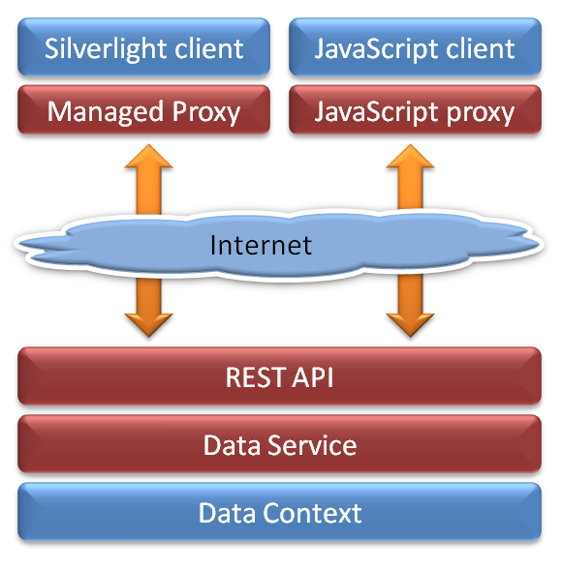
WCF Data Service

Slide 20
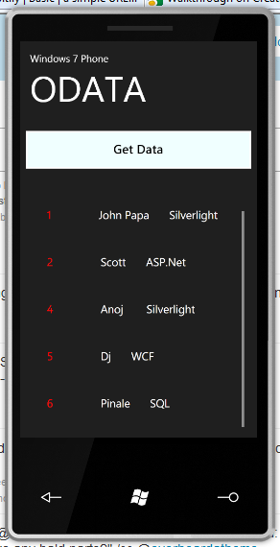
With W7Phone
Download ODATA client library for Windows 7 Phone
Create Proxy class
Consume in Windows 7 Phone app

Slide 21
DEBUGMODE_
http://dhananjaykumar.net
Q & A
Dhananjay Kumar

