Slide 1

http://twitter.com/DebugMode_
http://dhananjaykumar.net
REST for Developers
Dhananjay Kumar

Slide 2
REST is Service on Web
REST == Representational State Transfer
If we want our SERVICE to work in the same way as Web works , we will design our service as REST Service.

Slide 3
REST Everywhere
Windows Azure table CRUD operation is REST based
Twitter API , BING API , Google API all are exposing their service as REST
Mostly cloud services are REST based
WCF Data service and ODATA is REST based
SharePoint 2010 services are REST based

Slide 4
What is REST
REST is a architecture style not standard to design and create Service
REST is the Service on the Web
It uses HTTP protocol
It uses URI for resource identification

Slide 5
What is REST
REST stands for Representation State Transfer
REST is about accessing resources through a universal interface
Conceived in 2000 as a doctoral dissertation by Roy Fielding (a principal author of HTTP protocol)
RESTful URLs are addressable

Slide 6
Why REST ?
Highly scalable
Can be consumed in any type of client
Using standard HTTP protocols and verbs
Can be tested in browser
Can be consumed without creating proxy

Slide 7
What is not REST
Any HTTP-GET operation that is not reproducible
Other misuse of HTTP verbs
ASP.NET Web Site
A URL scheme that is not resource-based

Slide 8
Why not REST
If you have more secure Application
If you want to use other protocol than HTTP
If you want WS* standard transaction
If you want SOAP based service

Slide 9
Consumption of REST
REST
SILVERLIGHT
AJAX
Managed application
Browsers
Cloud hosted services
Any client which can process HTTP

Slide 10
HTTP Verbs
HTTP POST
HTTP GET
CREATE Resource
RETERIVE Resource
HTTP DELETE
UPDATE Resource
DELETE Resource
HTTP PUT

Slide 11
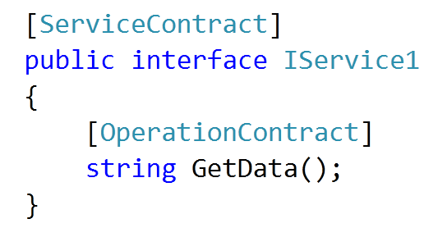
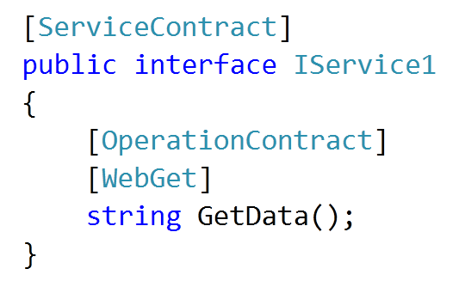
WCF REST
WCF REST Service
WCF SOAP Service

Slide 12
WCF REST
WCF REST Service
WCF SOAP Service

Slide 13
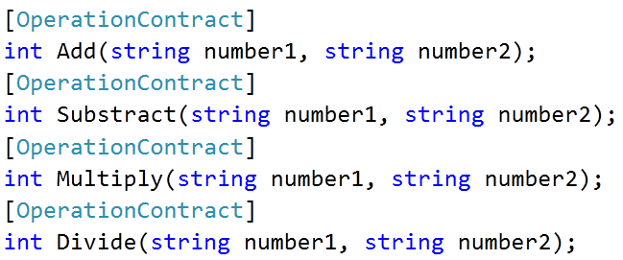
Resource identification
Resource
Resource
Resource
Resource

Slide 14
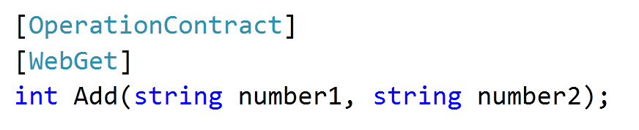
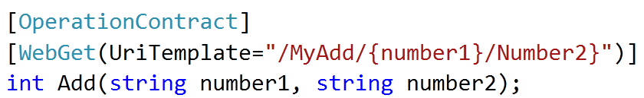
URI construction
http://localhost:9999/Service1.svc/Add?number1=7&number2=1
http://localhost:9999/Service1.svc/MyAdd/7/2

Slide 15
URI Formats
URI Template | HTTP Method | Operation
Session.svc/ | GET | Get all sessions
Session.svc/{id} | GET | Get one session
Session.svc/ | POST | Add a new session
Session.svc/{id} | PUT | Update a session
Session.svc/{id} | DELETE | Delete

Slide 16
Message format
JSON for AJAX clients
XMLfor any type of clients
Message Format
XML
JSON

Slide 17
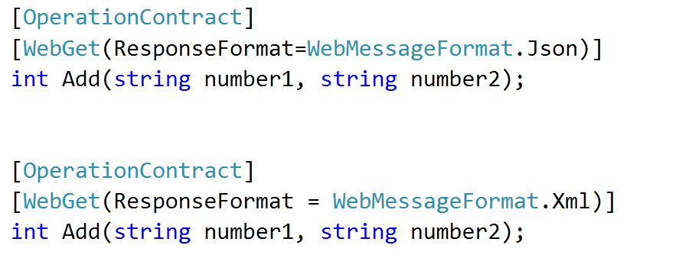
Message Formats

Slide 18
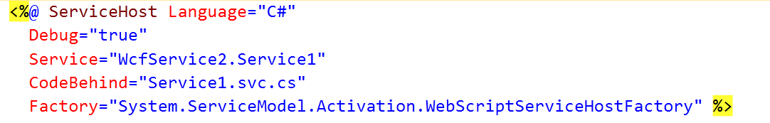
Configuration
There is no End Point specified in System.ServiceModel

Slide 19
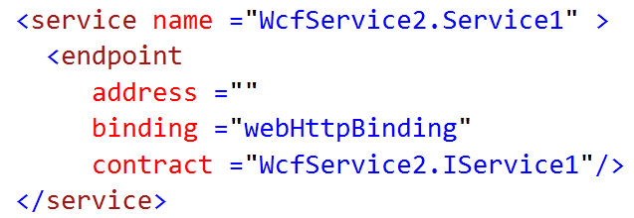
Configuration
There is no Meta data End Point for REST Service

Slide 20
Hosting Options
Can be hosted in IIS
Can be hosted in Managed Application
Can be hosted in default ASP.Net Web server
Can be hosted in WAS
Can be hosted in APP Fabric

Slide 21
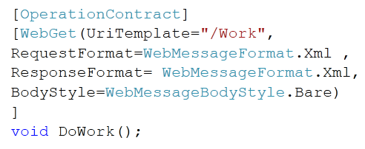
REST DEMO
Create your first WCF REST Service

Slide 22
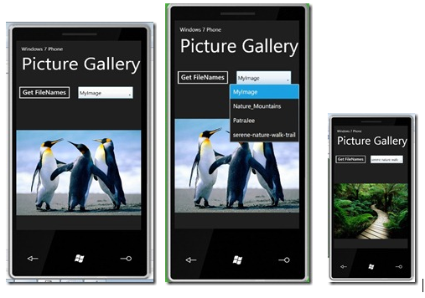
REST in Windows 7 Phone

Slide 23

Thank You
http://dhananjaykumar.net
http://twitter.com/DebugMode_

