Slide 1

http://twitter.com/DebugMode_
http://dhananjaykumar.net
Introduction to ODATA and WCF
DATA SERVICE
Dhananjay Kumar

Slide 2
What is REST
REST == Representational State Transfer
REST is a architecture style not standard to design and create Service
REST is the Service on the Web
It uses HTTP protocol
It uses URI for resource identification (REST)

Slide 3
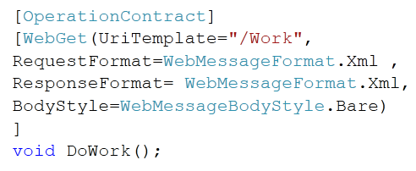
REST DEMO
Create your first WCF REST Service

Slide 4
WCF Data Service
WCF Data Service
ODATA
Project Astoria
ADO.Net Data Service

Slide 5

WCF Data Service
WCF Data Service
ODATA
Project Astoria
ADO.Net Data Service

Slide 6
ODATA
It is a web Protocol
It is used for updating and querying data
It uses HTTP protocol
It uses ATOM and JOSON web message formats
It uses URI for resource identification (REST)
OData is released under the Open Specification Promise to allow anyone to freely interoperate with OData implementations.

Slide 7
ODATA Consumer and Producer
Application :SharePoint 2010, IBM Web Sphere , SSRS, SQL Azure , Azure table
Live Services : facebook ,Pluralsight , vanGuide , TechEd2010, NerdDinner
Browsers , ODATA Explorer , Excel 2010 , LINQPAD, SesName Odata Browser
Client Librarries : W7Phone , Javascript , .Net , PHP
PRODUCER
CONSUMER

Slide 8
WCF Data Service
WCF Data Services Framework Consists of a combination of patterns and libraries that enable the creation and consumption of data services for the web.
The goal of WCF DATA Service is to facilitate the creation of Flexible data Services that are naturally integrated with the web
WCF Data Service exposes CRUD operation as REST service using ODATA protocol

Slide 9
HTTP Verbs
HTTP POST
HTTP GET
HTTP PUT
CREATE Data in Table
RETERIVE Data from table
HTTP DELETE
UPDATE Data in table
DELETE Data in table

Slide 10
Message format
JSON for AJAX clients
ATOM for any type of clients
Message Format
ATOM
JSON

Slide 11
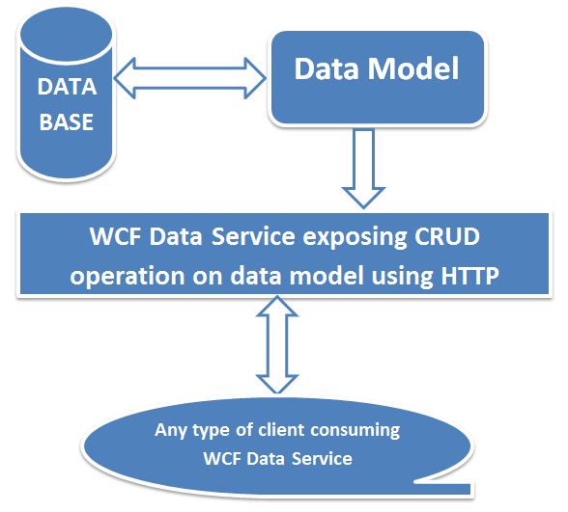
Flow diagram

Slide 12
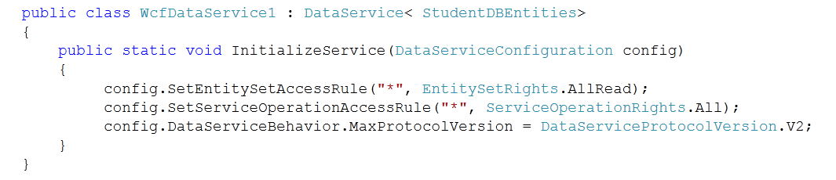
DEMO

Slide 13
DEMO
Demo #1 Creation of WCF Data Service
Demo #2 URI options
Demo #3 Consuming in Console Client
Demo #4 Server side Paging

Slide 14
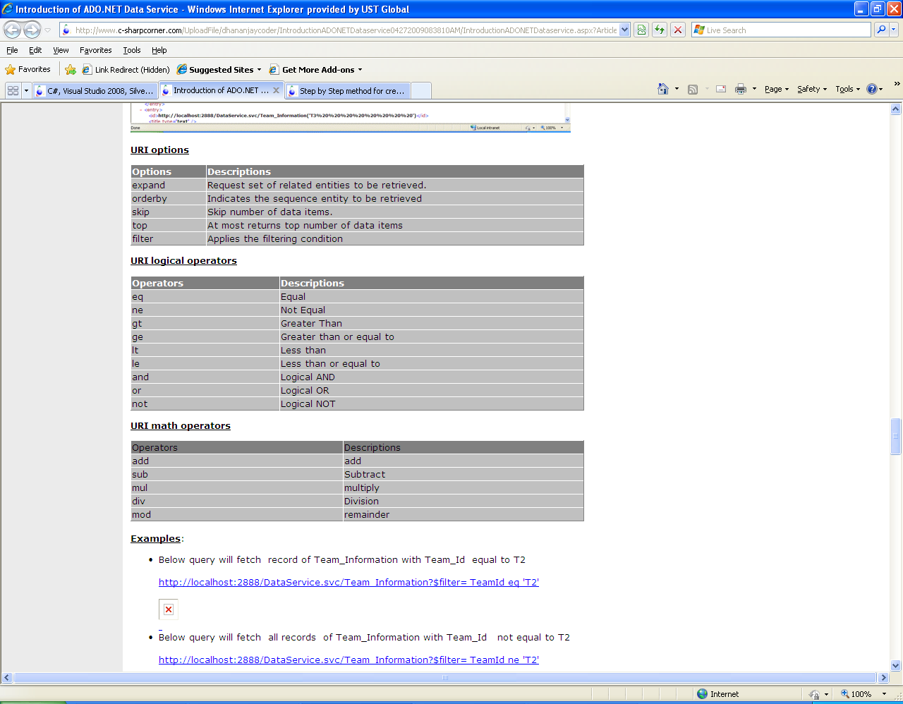
URI options in WCF Data Service

Slide 15
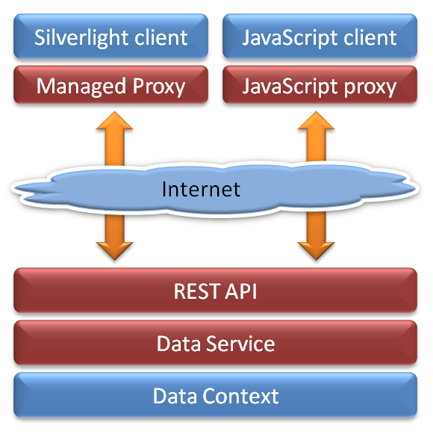
WCF Data Service

Slide 16
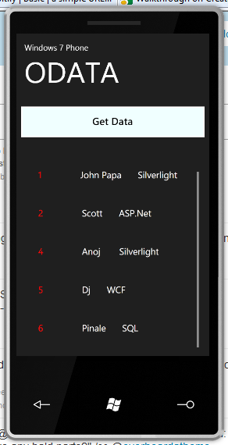
WCF Data Service +W7P App
Download ODATA client library for Windows 7 Phone
Remove digital signature
Create Proxy class
Consume in Windows 7 Phone app

Slide 17

Thank You
http://dhananjaykumar.net
http://twitter.com/DebugMode_

