Slide 1
ABC of and End Point
Dhananjay Kumar
MVP-Connected System

Slide 2
End Point
Contracts
Address
Binding
End Point

Slide 3




End Point
Service
Client
Endpoint
Endpoint
Message
Endpoint

Slide 4
End Point
ADDRESS
Where
BINDING
How
CONTRACT
What

Slide 5







End Point
Address, Binding, Contract
Client
Service
C
B
A
C
B
A
Message
C
B
A
Address
Binding
Contract
(Where)
(How)
(What)

Slide 6
End Point
<endpoint address=“http://localhost:8080/abc" binding="wsHttpBinding" contract="HotsingSamples.IService1">
</endpoint>

Slide 7
Address (A)
Every service is associated with a unique address.
Location of the Service
Transport protocol used in service
Address of the Service

Slide 8
Address (A)
Address specifies where the service is residing.
This is an URL( Uniform Resource Locator).
Address URL identifies , location of the service.
Address should follow the Web Service Addressing(WS-Addressing) standard.

Slide 9
Address (A)
WS Addressing
Scheme
Machine
Port
Path

Slide 10
Address (A)
Scheme
This is top level portion of the address. This is not as same as of protocols.
Machine
This identifies the machine name. This can be a public URL or a local identifier
Port
This is port number. This is an optional part.
Path
This is used to locate the path. This gives path of the service.

Slide 11
Address (A)
HTTP
http://localhost:8001/Dell
http://localhost/Dell
TCP
net.tcp://localhost:800/Dell
net.tcp://localhost/Dell
MSMQ
net.msmq/private/MyService
Net.msmq/://localhost/Dell
IPC
Peer network
net.pipe://localhost/MyPipe
Net.pipe://localhost.MyService

Slide 12
Binding (B)
  Describes how a service communicates.
  This specifies which Protocol to be used.
  This specifies the encoding method to format the message content.
  This specifies the Security requirements.
  This specifies the message exchange format.
  This specifies message session mode. Etc .
  Developer could create custom Binding also.

Slide 13
Binding (B)
  Transport Protocol
  Message Encoding
  Communication Pattern
  Security
  Transaction Property
  Inter Operability

Slide 14
Binding (B)
  basicHttpBinding
This is interoperable binding and commonly used as replacement for earlier web service based on ASMX.
This is designed to expose WCF service as legacy ASMX service such that old client can work with.
This also enables WCF client to work with ASMX
It supports HTTP & HTTPS protocols.
It supports MTOM/text encoding.

Slide 15
Binding (B)
  wsHttpBinding
This is a secure and interoperable binding.
This uses SOAP over HTTP.
This supports reliability, transaction and security over Internet.
This supports HTTP/HTTPS protocol.
This supports text and MTOM encoding.
This is default binding provided by WCF.
This Binding is interoperate with any party that supports WS standards.

Slide 16
Binding (B)
  wsDualHttpBinding
This supports all the feature of wsHttpBinding
This is mainly used for DUPLEX SERVICE CONTRACTS.
This supports bidirectional communication.
This is not a interoperable binding.

Slide 17
Binding (B)
  webHttpBinding
This is a secure binding.
This is a interoperable binding.
It only supports Http/Https protocol.
It does not use SOAP style of message .
It uses REST style of message.
It is mainly used for REST enabled services.

Slide 18
Binding (B)
  wsFederationHttpBinding
This is a secure Binding.
This is interoperable binding.
This supports federated security
This supports Https/Https protocols.
This uses text/MTOM encoding.
This supports Federated Identity.

Slide 19
Binding (B)
  netTCPBinding
This is a secure Binding.
This is optimize to use if client is also a WCF machine.
This is used to send Binary encoded SOAP message from one WCF computer to another.
This uses TCP (Transmission Control Protocol) for cross machine communication on the Intranet.
This supports reliability, transaction, security.
This requires both the client and service to use WCF.

Slide 20
Binding (B)
netNamedPipeBinding
This is most secure Binding.
This could be used over a single WCF computer.
This sends Binary encoded SOAP message over named pipes.
This uses named pipes as transport for same machine communication.

Slide 21
Binding (B)
netMSMQBinding
This is designed to offer support for disconnected queued calls.
This is a queued Binding.
This uses Binary encoded SOAP message.
This sends message over MSMQ.
Here communication should occur between two computers.

Slide 22
Binding (B)
netPeerTCPBinding
This is a secure Binding.
This uses TCP over peer to peer.
Communication should occur between two or more computers.

Slide 23
Binding (B)
basicHttpContextBinding
This Binding is same as of basicHttpBinding with more attributes , like below
It supports HTTP cookies
It enables SOAP headers to exchange context.
This binding is mainly used for Durable services.

Slide 24
Binding (B)
Choosing Binding
WCF
To
WCF
No
Yes
Disconnected
Calls
No
Yes
Legacy
ASMX
Cross
Machine
No
Yes
No
Yes
WS
Basic
IPC
TCP
MSMQ

Slide 25
Binding (B)
Binding Classes
Binding Name as of class | Transport | Encoding | Interoperable
BasicHttpBinding | HTTP/HTTPS | Text,MTOM | Yes
NetTcpBinding | TCP | Binary | No
NetPeerBinding | P2P | Binary | No
NetNamedPipeBinding | IPC | Binary | No
WSHttpBinding | HTTP/HTTPS | Text,MTOM | Yes
WSFederationHttpBinding | HTTP/HTTPS | Text,MTOM | Yes
WSDualHttpBinding | HTTP | Text,MTOM | Yes
NetMsmqBinding | MSMQ | Binary | No
MsmqIntegrationBinding | MSMQ | Binary | Yes

Slide 26
Binding (B)
Configuring Binding
<endpoint address="Calculator"
bindingSectionName="basicProfileBinding"
bindingConfiguration="Binding1"
contractType="ICalculator" />
<bindings>
<basicProfileBinding>
<binding configurationName="Binding1"
hostnameComparisonMode="StrongWildcard"
transferTimeout="00:10:00"
maxMessageSize="65536"
messageEncoding="Text"
textEncoding="utf-8"
</binding>
</basicProfileBinding>
</bindings>

Slide 27
Contract (C)
  A WCF Contract is a collection of Operations
  that specifies what the Endpoint communicates
  to the outside world.
  All WCF services exposes contract.
  This is a platform neutral and standard way to say , what the service will do.
  Defines , what a Service communicates.

Slide 28
Contract (C)
  Types of Contracts
Service Contract
Describes which operation client can perform on the services.
Data Contract
Defines which Data Type are passed to and from the services. It provides built-in contract for implicit type.
Fault Contract
Which error raise by service and how service propagates and handles error to its client.
Message Contract
Allow the service to interact directly with the message . Message contract can be typed or un typed. This can be used for interoperability.
Microsoft Innovation & Practice Team, MSCoE
28

Slide 29
Contract (C)
  Service Contract
  A Service Contract reflects specific business
  knowledge and is the basis for sharing and
  reusing service.
  Describe which operations client can perform
  on the service.
  Maps CLR types to WSDL
Microsoft Innovation & Practice Team, MSCoE
29

Slide 30
Contract (C)
  Service Contract
  Interfaces are used to explicitly define a
  Contract.
  Classes may also be used to define a Contract.
  [ServiceContract] attribute is being used by
  interface/class to qualify them as a contract.
  ServiceContract are implicitly public.
Microsoft Innovation & Practice Team, MSCoE
30

Slide 31
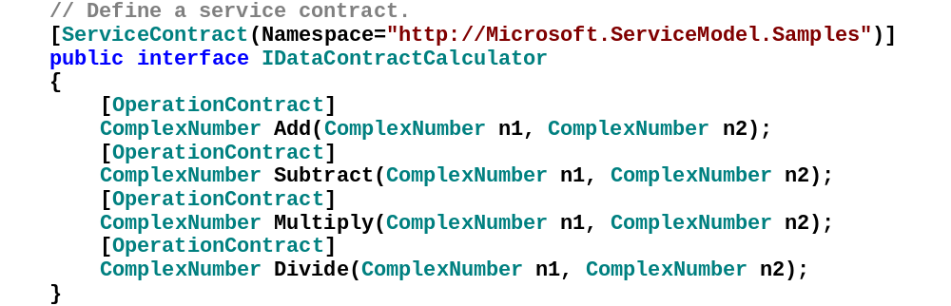
Contract (C)
  Service Contract
31

Slide 32
Contract (C)
  Data Contract
  These are the contractual agreement about the format and structure of the payload data in message exchange between a service and its consumer.
  Defines which Data types are passed to and from the service.
  Its specifies CLR type to XML schema.
32

Slide 33
Contract (C)
  Data Contract
  DataContract are preferred WCF way to enable Serialization.
  WCF defines implicit contract for built in types like int and string.
  Developer has to explicitly expose complex types as Data Contract.
  [DataContract] and [DataMember] attribute are used to define a type as Data Contract.
33

Slide 34
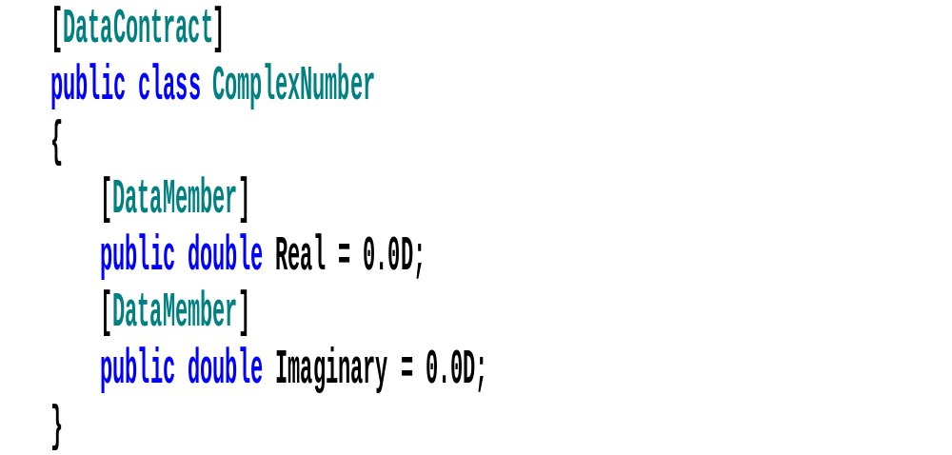
Contract (C)
  Data Contract
34

Slide 35
Contract (C)
  Message Contract
  It gives control over SOAP message structure on both header and body content.
  Developer can designate optional SOAP headers.
  It provides additional control over the WSDL generation.
  It is used to interoperate with another non- WCF service.
  It is used to control security issue at level of message.
35

Slide 36
Contract (C)
  Fault Contract
  This translates .Net Exception to SOAP fault propagated to consumer.
  This can be applied to operation only.
  This is not Inheritable.
  This can be applied multiple times.
  This enables developer to declare which faults a given service operation might issue if things goes wrong.
36

Slide 37
Creating End Point
  Could be created declaratively in configuration file.
  Could be created imperatively through code.
  Any thing done through code can be done with configuration file and vice versa.
  It is considered good practice to use configuration file to specify End points. This accommodates changes without recompiling the code.
37

Slide 38
Multiple End Point
  For service exposed to multiple clients ; it makes sense to specify more than one End point.
  This enables client to use the endpoint that is most applicable for them.
  When creating multiple endpoints each client must have unique address
  If two client uses the same address , error will raise at service load time.
38

Slide 39
Multiple End Point
<endpoint address="http://localhost:8890/a" binding="wsHttpBinding" contract="HotsingSamples.IService1"/>
<endpoint address="http://localhost:8000/b" binding="basicHttpBinding" contract="HotsingSamples.IService1"/>
<endpoint address="net.tcp://localhost:8001/c" binding="netTcpBinding" contract="HotsingSamples.IService1"/>
39

Slide 40
Thank You.
Dhananjay Kumar
MVP-Connected System

