Slide 1
WCF Data Service &REST
Dhananjay Kumar
MVP-Connected System

Slide 2
Agenda
What is REST?
Introduction to WCF Data Services
Demo
URI Options
Future Scope
Q/A

Slide 3
REST
REST == Representational State Transfer
“Representation State Transfer is intended to evoke an image of how a well-designed Web application behaves: a network of web pages (a virtual state-machine), where the user progresses through an application by selecting links (state transitions), resulting in the next page (representing the next state of the application) being transferred to the user and rendered for their use.”
- Roy Fielding
REST is an architectural style, not a standard
Induces scalability, generality, extensibility
While REST is not a standard, it does prescribe the use of standards:
  HTTP
  URL
  XML/HTML/GIF/JPEG/etc (Resource Representations)
  text/xml, text/html, image/gif, image/jpeg, etc (Resource Types, MIME Types).

Slide 4
REST
Key principles
"Identification of resources"
  Resources are anything that can be named
  Each resource is having a unique URI.
"Manipulation of resources through representations"
  Representations capture current/intended state of resources
  Representations are transferred between resources
  Representations often contain links to related resources
"Self-descriptive messages"
  Resource identifiers, representation data formats,
"Hypermedia as the engine of application state"

Slide 5
RESTful Example
HTTP Client
(Web Browser)
Web Server
Database
GET/book?ISBN=222
SELECT *
FROM books
WHERE isbn=222
PUT/order
INSERT
INTO orders
301 Location:/order/612
UPDATE orders
WHERE id=612
POST /order/612

Slide 6
REST
DEMO

Slide 7
WCF Data Service
WCF Data Service
ADO.Net Data Service
ODATA
Project Astoria
Data services for cloud

Slide 8
WCF Data Services
Introduction
The ADO.NET Data Services Framework Consists of a combination of patterns and libraries that enable the creation and consumption of data services for the web.
The goal of ADO.NET Data Service Framework is to facilitate the creation of Flexible data Services that are naturally integrated with the web.
It is a RESTful interface to data which exposed and
supports all database operations (CRUD) as RESTful
service on an entity model, if entity model supports
both IUpdateable and IQueryable interface.

Slide 9
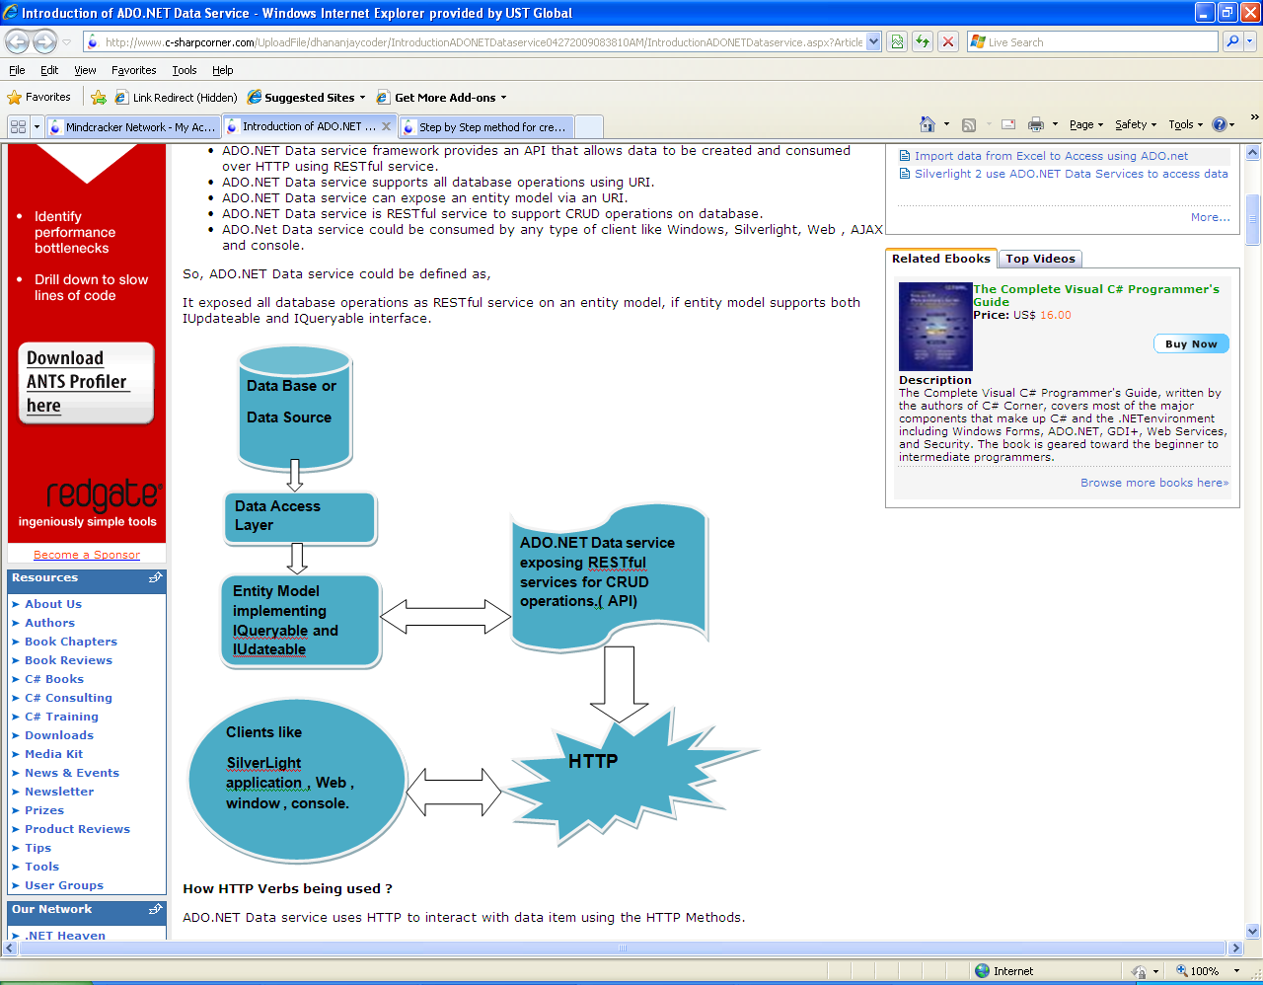
WCF Data Service
Visual representation

Slide 10
WCF Data Service
It is a framework which provides an API that allows data to be created and consumed over HTTP using RESTful service.
It supports all database operations using URI.
It can expose an entity model via an URI.
It is RESTful service to support CRUD operations on database.
It could be consumed by any type of clients like Windows, SilverLight, Web , AJAX and console.

Slide 11
WCF Data Service
HTTP verbs
Create
HTTP POST
Read
HTTP GET
Update
DeleteHT
HTTP DELETE
HTTP PUT

Slide 12
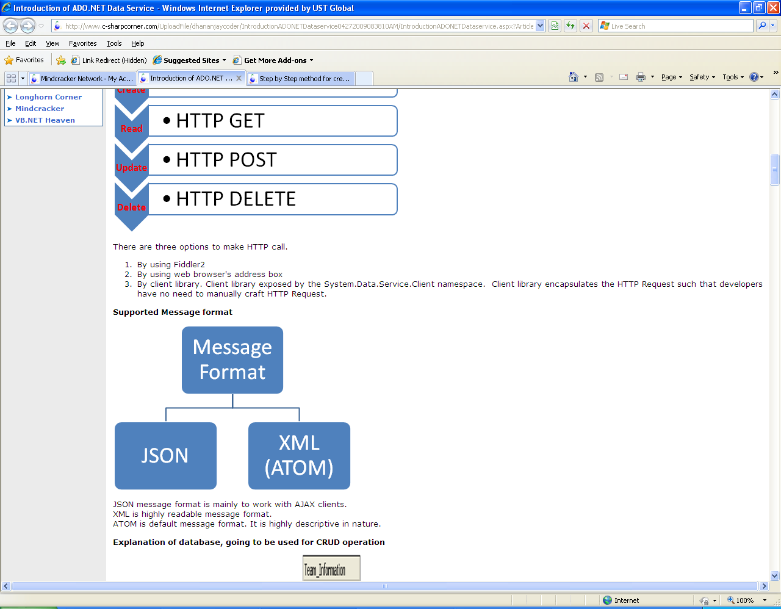
WCF Data Service
MESSAGE FORMAT
JSON message format is mainly to work with AJAX clients.
XML is highly readable message format.
ATOM is default message format. It is highly descriptive in nature.
It is RESTful service to support CRUD operations on database.

Slide 13
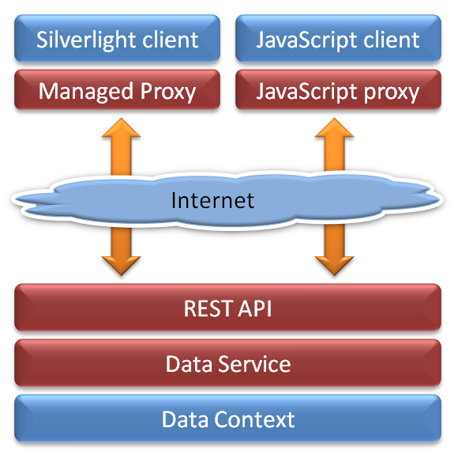
WCF Data Service
Silverlight and ajax client

Slide 14
WCF Data Service
DEMO

Slide 15
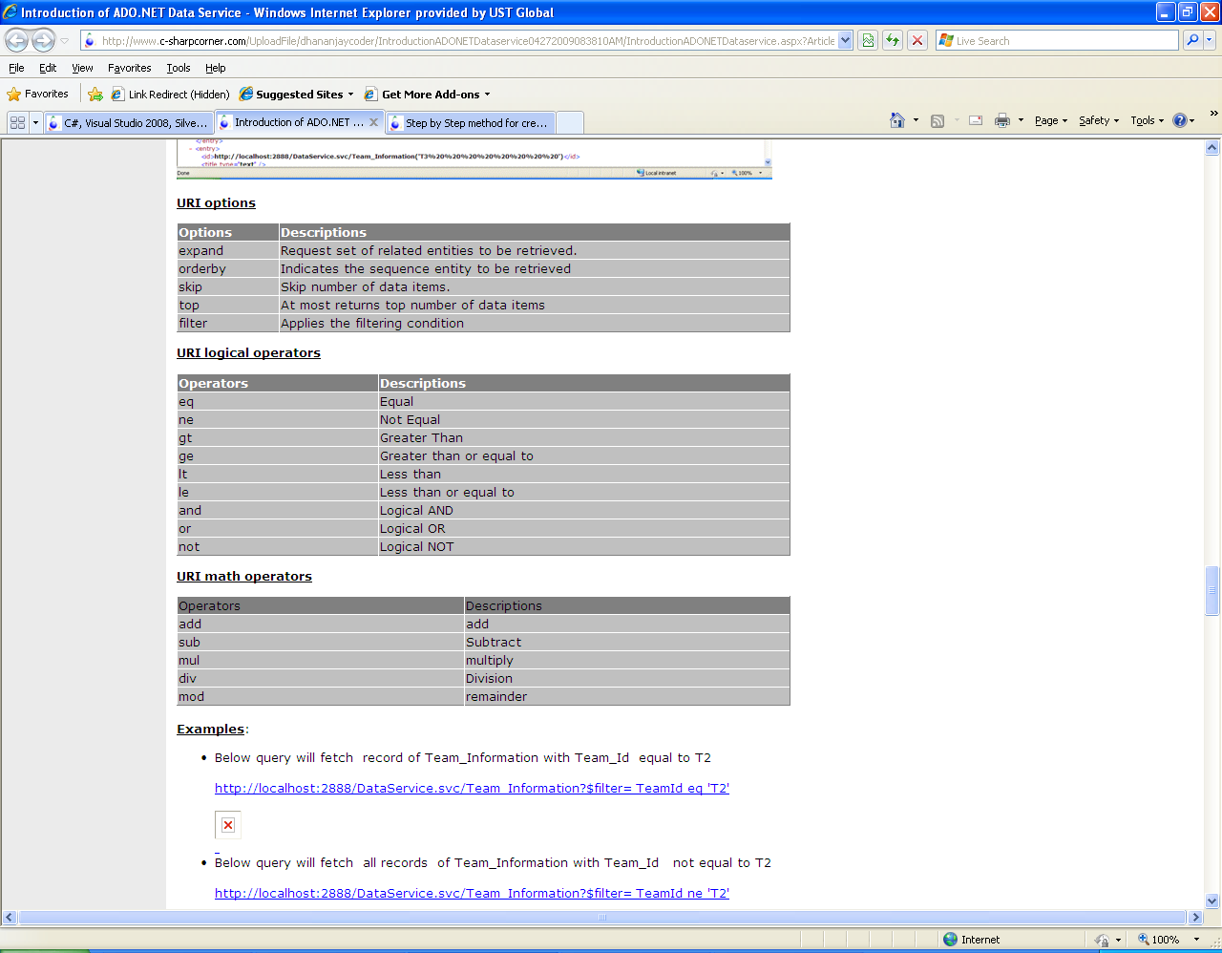
WCF Data Service
Uri options & operators

Slide 16
WCF Data Service
Qs ???

Slide 17
Thank You.
Dhananjay Kumar
MIT (MSCoE)

